Slide 1


Stock Market Analysis P97 – Group 2
Mentor
Kartik
Himavanth

Slide 2



Business Problem
To predict the outcomes, trends, or expected future behavior of business, industry sector, or the economy using statistics.

Slide 3

OBJECTIVE
The goal here is to make the companies and businesses to understand and analyse the market to lower their expenses and enhance profits along with helping the investors in identifying purchasing and selling patterns by using Modern Data Analytics.

Slide 4

FORECASTING
In simple terms forecasting means, “estimation or prediction of future”.
Forecasting is an operational research technique used as basis of management planning and decision making.
Forecasting is a systematic guessing of the future course of events.
Forecasting provides a basis for a planning.
According to Henry Foyal, Forecasting includes both accessing the future and making provision for it.

Slide 5
PROJECT ARCHITECTURE / PROJECT FLOW
Data Collection
NSE/BSE Data
Data Cleaning and EDA
Feature extraction/ Visualization
Model Building
Model Evaluation
Deployment

Slide 6
5 years NSE Data of Reliance Indus. Ltd.
 | Date | Symbol | Series | Prev Close | Open | High | Low | Last | Close | VWAP | Volume | Turnover | Trades | Deliverable Volume | %Deliverble
0 | 2017-01-02 | RELIANCE | EQ | 1082.40 | 1084.00 | 1090.0 | 1072.35 | 1086.70 | 1085.10 | 1086.63 | 1622458 | 1.763016e+14 | 38903 | 881915 | 0.5436
1 | 2017-01-03 | RELIANCE | EQ | 1085.10 | 1089.85 | 1097.0 | 1081.10 | 1089.00 | 1089.40 | 1091.74 | 1470751 | 1.605682e+14 | 31291 | 776985 | 0.5283
2 | 2017-01-04 | RELIANCE | EQ | 1089.40 | 1092.90 | 1093.0 | 1064.30 | 1067.15 | 1067.15 | 1072.39 | 2375547 | 2.547514e+14 | 70540 | 1516724 | 0.6385
3 | 2017-01-05 | RELIANCE | EQ | 1067.15 | 1071.00 | 1079.9 | 1068.75 | 1077.00 | 1077.40 | 1077.12 | 1996483 | 2.150452e+14 | 84058 | 1272212 | 0.6372
4 | 2017-01-06 | RELIANCE | EQ | 1077.40 | 1074.20 | 1085.0 | 1073.10 | 1073.95 | 1074.95 | 1078.77 | 1793427 | 1.934704e+14 | 66643 | 1121595 | 0.6254

Slide 7
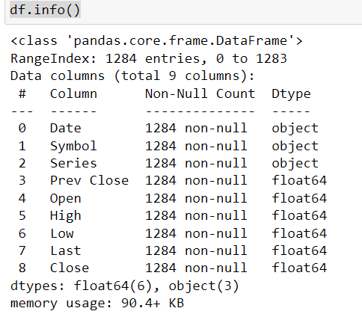
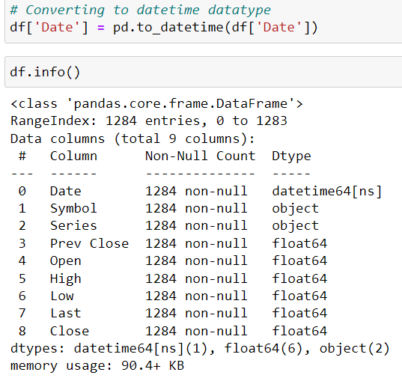
1. EDA - ( Exploratory Data Analysis )

Slide 8
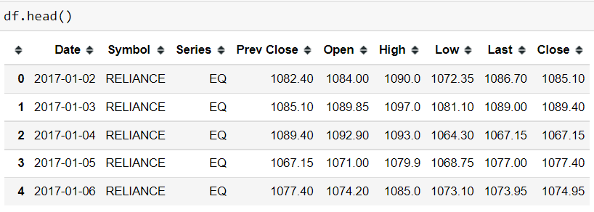
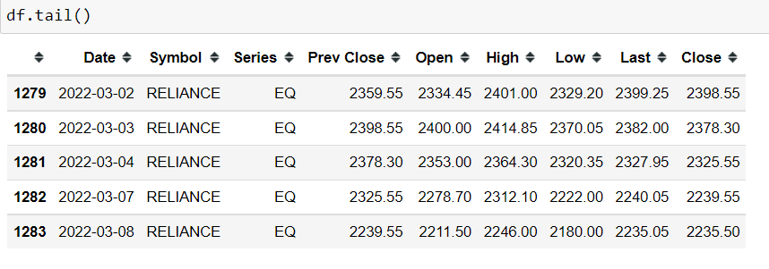
After the date time datatype conversion.

Slide 9
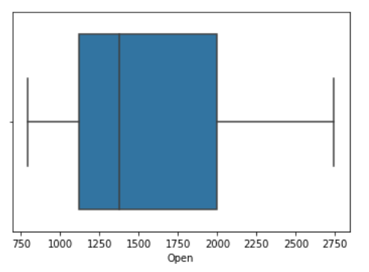
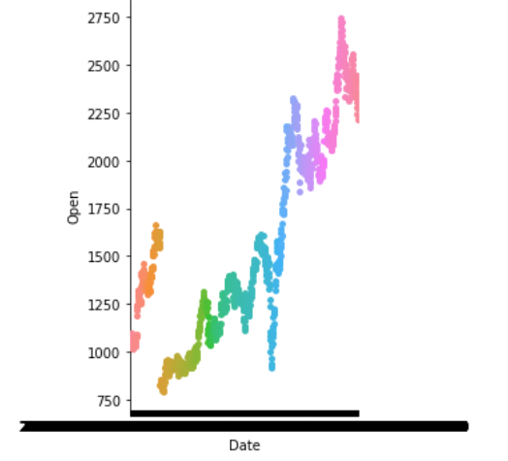
2. Visualization
Boxplot
Catplot

Slide 10
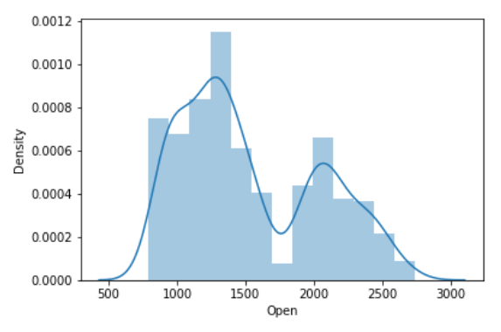
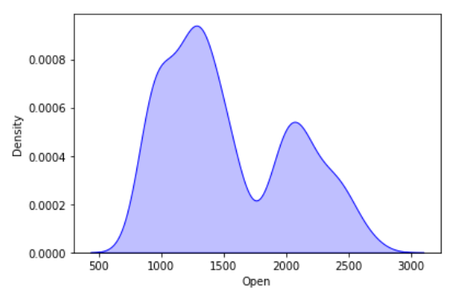
Kdeplot
Distplot

Slide 11
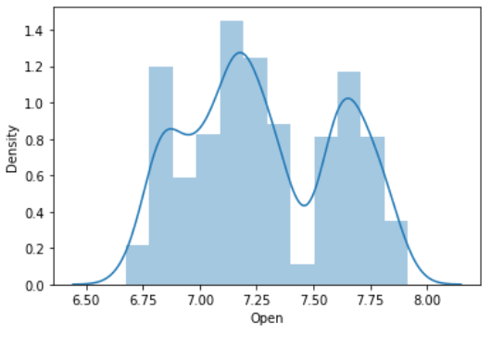
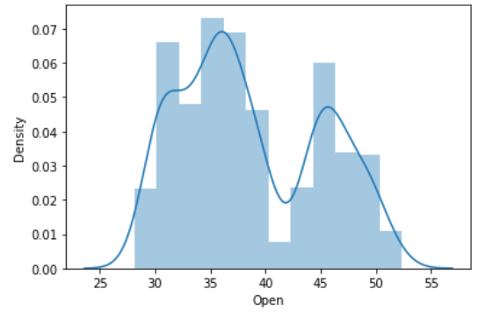
Log Transformation
Square root Transformation

Slide 12
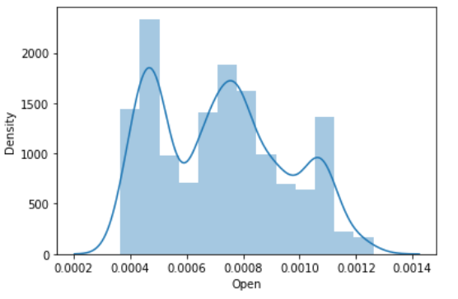
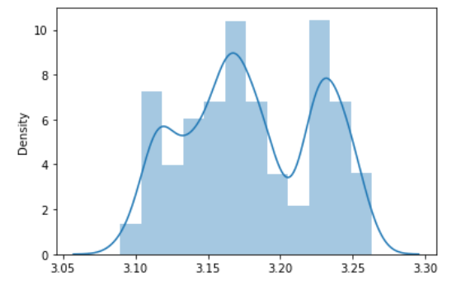
Reciprocal Transformation
Box Cox Transformation

Slide 13
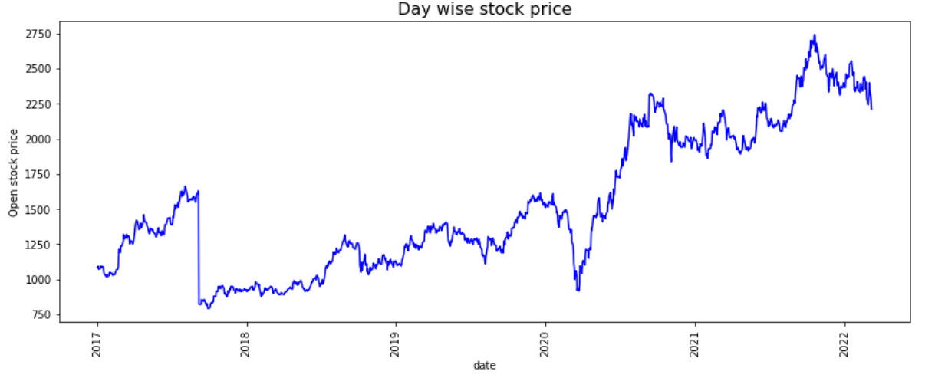
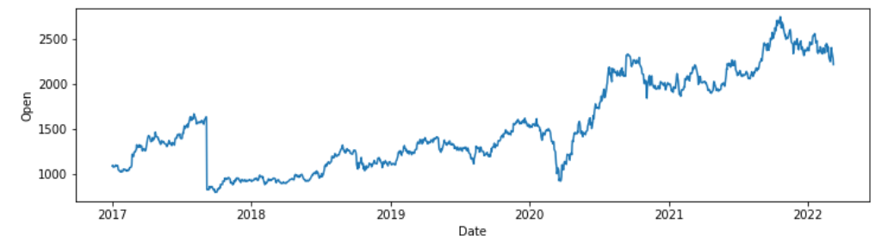
Before Transformation
After Transformation

Slide 14
5 years NSE Data of Tata Motors Ltd.
 | Date | Open | High | Low | Close | Volume | Dividends | Stock Splits
0 | 2017-03-08 | 469.399994 | 469.600006 | 461.149994 | 462.799988 | 5351597 | 0 | 0
1 | 2017-03-09 | 462.450012 | 469.700012 | 462.000000 | 467.600006 | 3837624 | 0 | 0
2 | 2017-03-10 | 471.000000 | 471.850006 | 465.100006 | 469.100006 | 5766815 | 0 | 0
3 | 2017-03-14 | 481.000000 | 483.000000 | 468.450012 | 469.750000 | 6348198 | 0 | 0
4 | 2017-03-15 | 475.000000 | 476.549988 | 470.649994 | 473.450012 | 4801312 | 0 | 0
5 | 2017-03-16 | 478.700012 | 482.000000 | 476.149994 | 480.950012 | 6272947 | 0 | 0
6 | 2017-03-17 | 481.350006 | 484.200012 | 471.700012 | 476.500000 | 6338248 | 0 | 0
7 | 2017-03-20 | 476.549988 | 478.200012 | 470.750000 | 476.000000 | 2871104 | 0 | 0
8 | 2017-03-21 | 478.000000 | 478.049988 | 470.649994 | 473.750000 | 4685410 | 0 | 0
9 | 2017-03-22 | 469.950012 | 469.950012 | 458.500000 | 459.899994 | 4695648 | 0 | 0

Slide 15
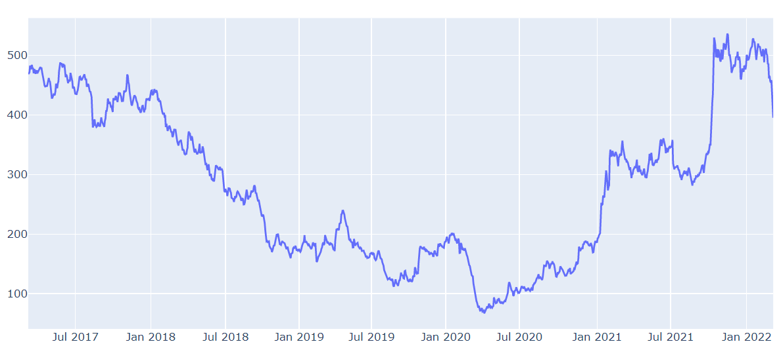
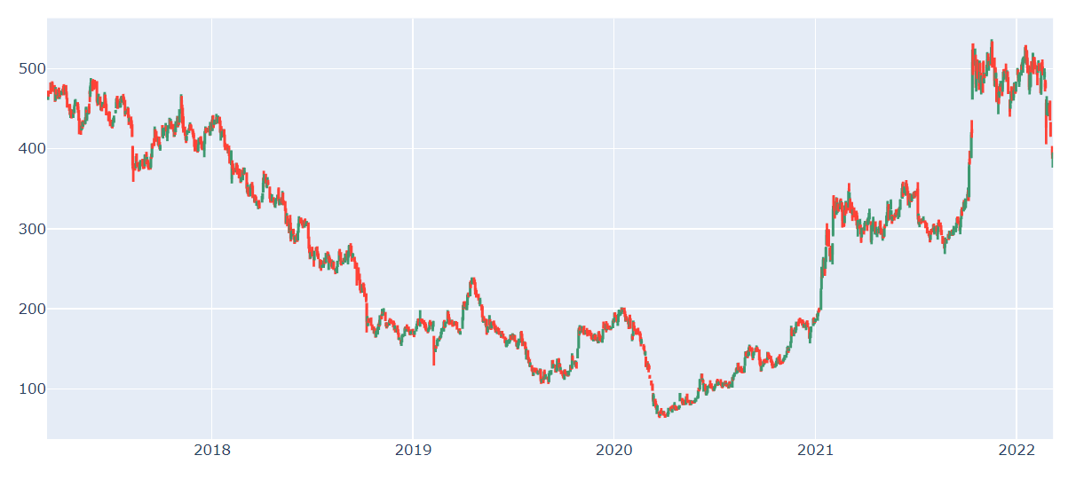
Line Chart
Candlestick Chart

Slide 16
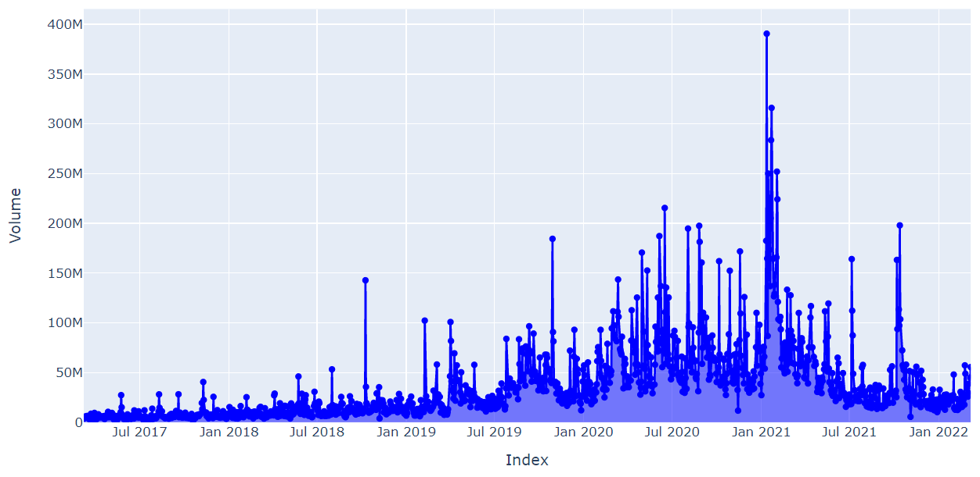
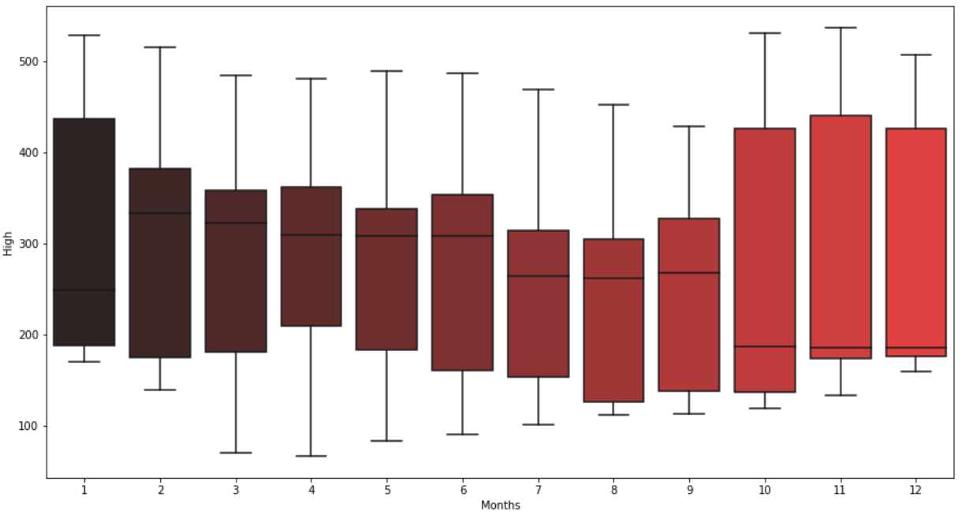
Volume Plot
Boxplot

Slide 17
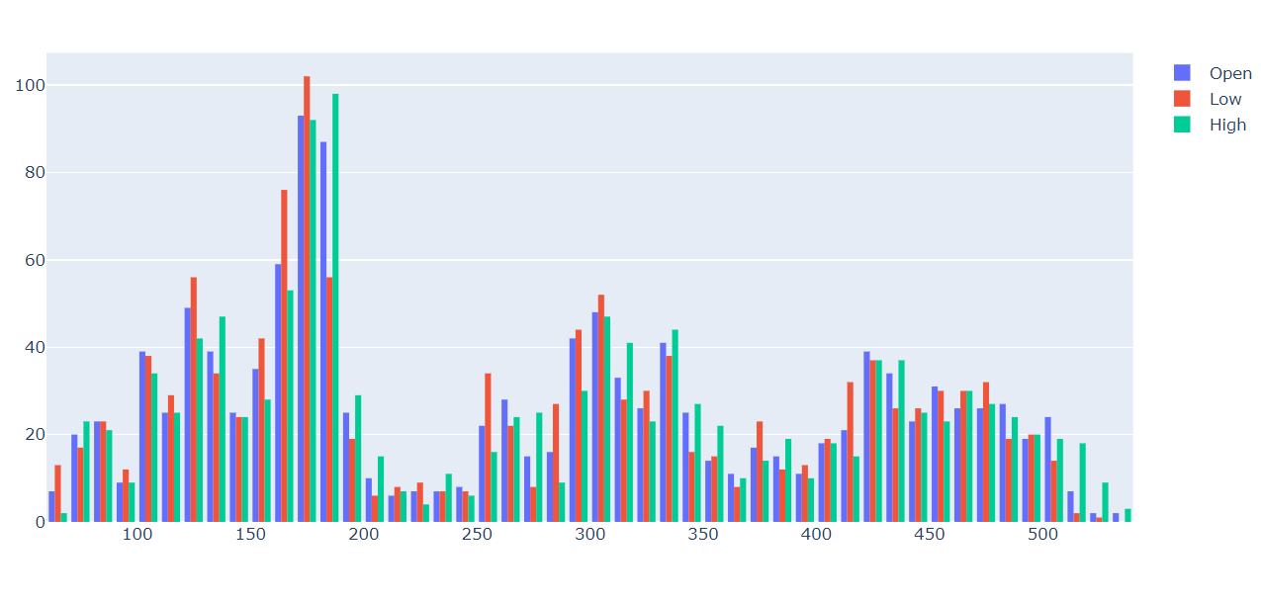
Histogram

Slide 18
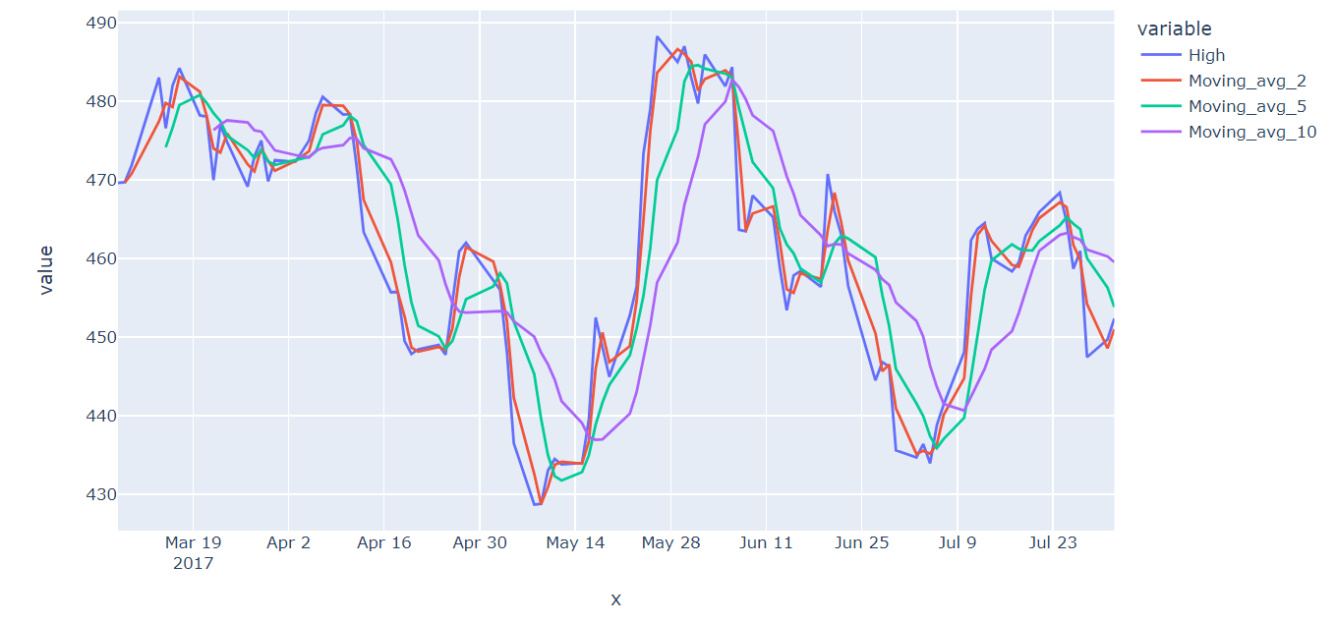
Moving Average plot

Slide 19



Presented By
Thank you
Piyush Mahajan
Tushar Khutale
Rushabh Rode
Geetanjali Vijaykumar

